Slide 1
Dependency Injection
A journey on what we know and beyond

Slide 2

Dependency Injection(DI)
-What is DI ?
-Why DI?
-Design pattern / Framework ?
-Angularjs DI vs Angular DI?
-How Angular DI works?

Slide 3

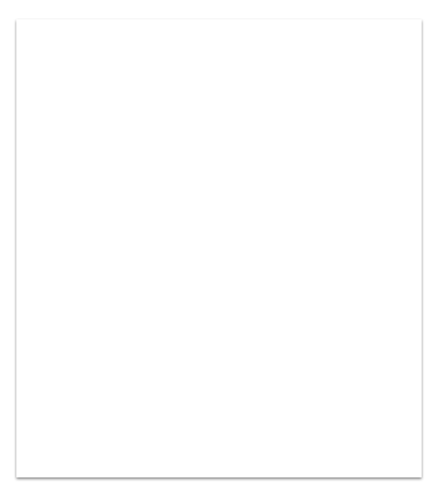

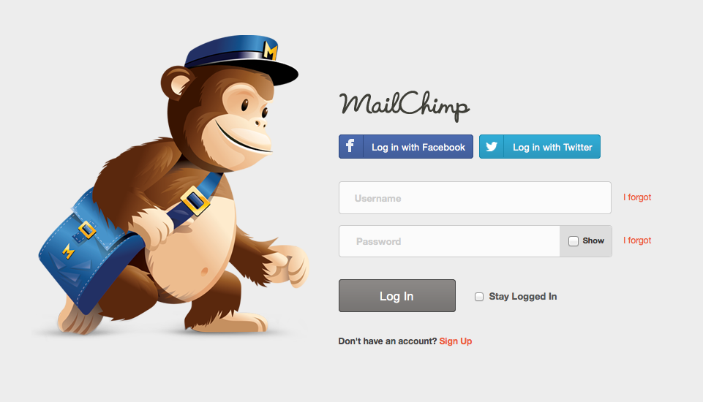
What is DI
Way to Managing dependencies, to help .clean and fast development
Authentication service
Login form

Slide 4
function LoginForm(){ var authService = new AuthenticationService(); var userDetails = { userName: ..., password: ... } authService.signin(userDetails); }

Slide 5
Reusable / Testable ?
function Login(authService:AuthenticationService){ var userDetails = { userName: ..., email: ... } authService.signin(userDetails); }
Tips
Reusable, code is always testable

Slide 6
More …..?
Integrate social media api
Facebook Authenticate with facebook api
Twitter Authenticate with twitter api
var authService = new FacebookUserAuthentication(); Login(authService);
var authService = new GoogleAuthenticationService(); Login(authService);
DI refined: software design pattern implements Inversion of Control(Ioc)

Slide 7
DI - framework
Dependency
Injector
Provider

Slide 8

Problems in Angularjs DI
Name Collision
Singleton/Internal Cache
Tightly coupled with framework
Tip DI of Angular can be used with JS libraries/Frameworks Now.
*React with Angular DI

Slide 9
Provider
Creates the Dependency
Dependency
Real object which needs to be served
Injector
Serves dependency based on name
Dependency <-> Injector <-> Provider
Food <-> Server <-> Chef
Story strictly for illustration purposes only

Slide 10

Let’s jump in

Slide 11
Happy Learning
Thank you for all your valuable time
Visit: https://github.com/balajiramalingam/angular-in-developer-lens

